Slide 1
From Policy Gradient to Actor-Critic
姜修齐

Slide 2
Policy Gradient
Q-learning
Actor-Critic

Slide 3











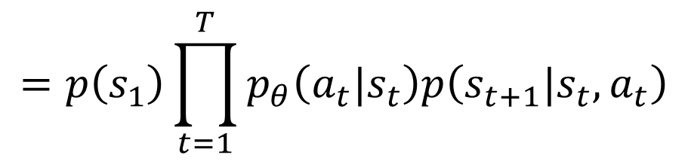
Policy Gradient
$$s_{1}$$
$$a_{1}$$
$$s_{2}$$
$$a_{2}$$
Env
Actor
Env
Actor
Env
……
$$s_{1}$$
$$a_{1}$$
$$s_{2}$$
$$a_{2}$$
$$s_{3}$$
Trajectory
$$τ=\left\{s_{1},a_{1}, s_{2},a_{2}, ⋯,s_{T},a_{T}\right\}$$
$$p_{θ}\left(τ\right)$$
$$=p\left(s_{1}\right)p_{θ}\left(a_{1}|s_{1}\right)p\left(s_{2}|s_{1},a_{1}\right)p_{θ}\left(a_{2}|s_{2}\right)p\left(s_{3}|s_{2},a_{2}\right)⋯$$
$$=p\left(s_{1}\right)\prod_{t=1}^{T}{p_{θ}\left(a_{t}|s_{t}\right)p\left(s_{t+1}|s_{t},a_{t}\right)}$$

Slide 4

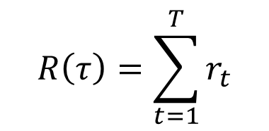

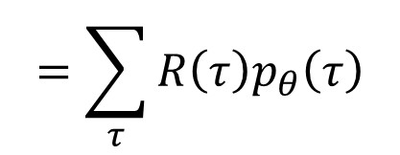


Policy Gradient
$$s_{1}$$
$$a_{1}$$
$$s_{2}$$
$$a_{2}$$
Env
Actor
Env
Actor
Env
……
$$s_{1}$$
$$a_{1}$$
$$s_{2}$$
$$a_{2}$$
$$s_{3}$$
Reward
Reward
$$r_{1}$$
$$r_{2}$$
Expected Reward
$$R\left(τ\right)=\sum_{t=1}^{T}{r_{t}}$$
$$=\sum_{τ}{R\left(τ\right)p_{θ}\left(τ\right)}$$
$${\overline{R}}_{θ}$$
$$=E_{τ\sim p_{θ}\left(τ\right)}\left[R\left(τ\right)\right]$$
Notes:
Ref: https://www.youtube.com/watch?v=W8XF3ME8G2I

Slide 5
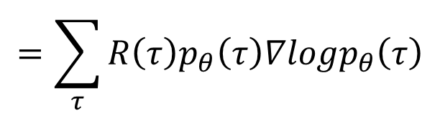


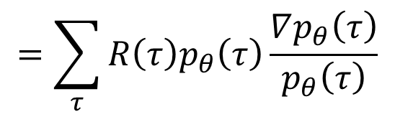
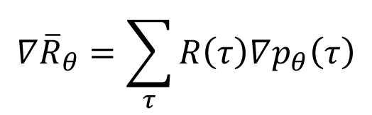

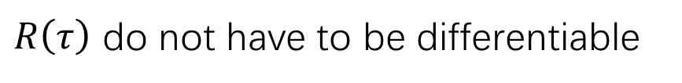

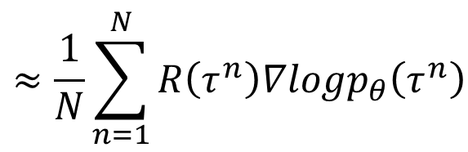
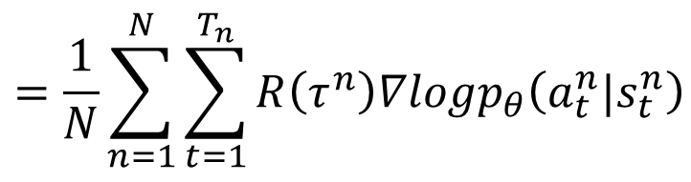
Policy Gradient
$$=\sum_{τ}{R\left(τ\right)p_{θ}\left(τ\right)}$$
$${\overline{R}}_{θ}$$
$$∇{\overline{R}}_{θ}=?$$
$$∇{\overline{R}}_{θ}=\sum_{τ}{R\left(τ\right)∇p_{θ}\left(τ\right)}$$
$$=\sum_{τ}{R\left(τ\right)p_{θ}\left(τ\right)\frac{∇p_{θ}\left(τ\right)}{p_{θ}\left(τ\right)}}$$
$R\left(τ\right)$ do not have to be differentiable
It can even be a black box.
$$=\sum_{τ}{R\left(τ\right)p_{θ}\left(τ\right)∇logp_{θ}\left(τ\right)}$$
$$≈\frac{1}{N}\sum_{n=1}^{N}{R\left(τ^{n}\right)∇logp_{θ}\left(τ^{n}\right)}$$
$$=E_{τ\sim p_{θ}\left(τ\right)}\left[R\left(τ\right)∇logp_{θ}\left(τ\right)\right]$$
$$=\frac{1}{N}\sum_{n=1}^{N}{\sum_{t=1}^{T_{n}}{R\left(τ^{n}\right)∇logp_{θ}\left(a_{t}^{n}|s_{t}^{n}\right)}}$$
Notes:
Use $π_{θ}$to play the game N times,
Obtain $\left\{τ^{1},τ^{2},⋯,τ^{N}\right\}$

Slide 6










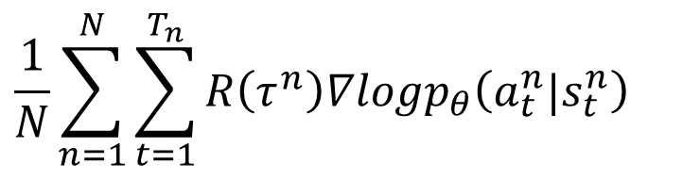




Policy Gradient
$$∇{\overline{R}}_{θ}=E_{τ\sim p_{θ}\left(τ\right)}\left[R\left(τ\right)∇logp_{θ}\left(τ\right)\right]$$
Update
Model
Given policy $π_{θ}$
$$τ^{1}:$$
$$\left(s_{1}^{1},a_{1}^{1}\right)$$
$$R\left(τ^{1}\right)$$
$$θ←θ+η∇{\overline{R}}_{θ}$$
$$\left(s_{2}^{1},a_{2}^{1}\right)$$
$$R\left(τ^{1}\right)$$
$$∇{\overline{R}}_{θ}=$$
……
……
$$\frac{1}{N}\sum_{n=1}^{N}{\sum_{t=1}^{T_{n}}{R\left(τ^{n}\right)∇logp_{θ}\left(a_{t}^{n}|s_{t}^{n}\right)}}$$
$$τ^{2}:$$
$$\left(s_{1}^{2},a_{1}^{2}\right)$$
$$R\left(τ^{2}\right)$$
$$\left(s_{2}^{2},a_{2}^{2}\right)$$
$$R\left(τ^{2}\right)$$
……
……
Data
Collection
only used once

Slide 7
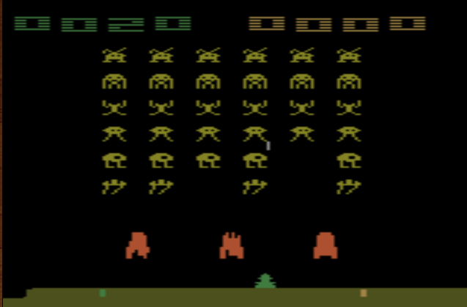
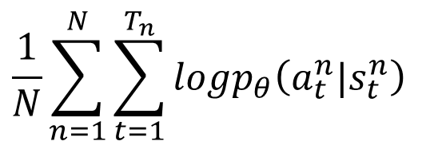






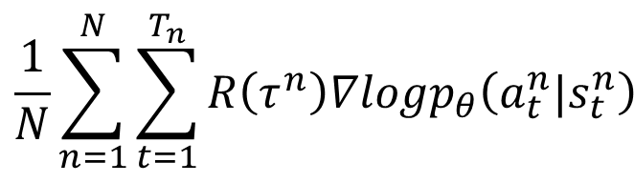
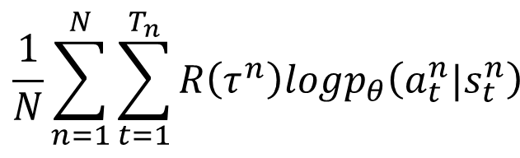
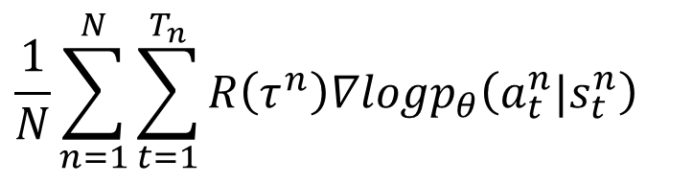
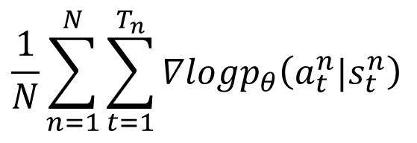

$$θ←θ+η∇{\overline{R}}_{θ}$$
Implementation
$$\frac{1}{N}\sum_{n=1}^{N}{\sum_{t=1}^{T_{n}}{R\left(τ^{n}\right)∇logp_{θ}\left(a_{t}^{n}|s_{t}^{n}\right)}}$$
$$∇{\overline{R}}_{θ}=$$
$$s_{t}^{n}$$
$$a_{t}^{n}$$
$$R\left(τ^{n}\right)$$
Consider as classification problem
left
1
$$a_{t}^{n}$$
…
right
0
…
$$s_{t}^{n}$$
fire
0
$$\frac{1}{N}\sum_{n=1}^{N}{\sum_{t=1}^{T_{n}}{logp_{θ}\left(a_{t}^{n}|s_{t}^{n}\right)}}$$
$$\frac{1}{N}\sum_{n=1}^{N}{\sum_{t=1}^{T_{n}}{∇logp_{θ}\left(a_{t}^{n}|s_{t}^{n}\right)}}$$
$$\frac{1}{N}\sum_{n=1}^{N}{\sum_{t=1}^{T_{n}}{R\left(τ^{n}\right)logp_{θ}\left(a_{t}^{n}|s_{t}^{n}\right)}}$$
$$\frac{1}{N}\sum_{n=1}^{N}{\sum_{t=1}^{T_{n}}{R\left(τ^{n}\right)∇logp_{θ}\left(a_{t}^{n}|s_{t}^{n}\right)}}$$

Slide 8
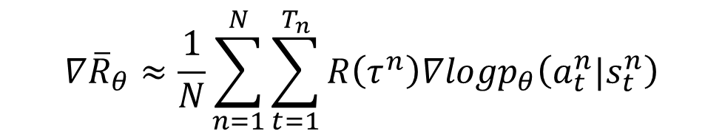



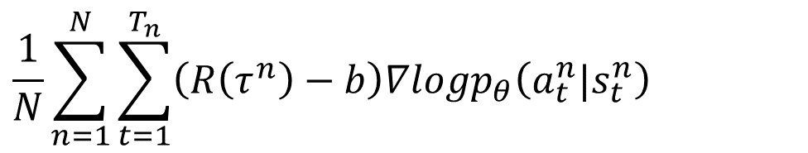
Tip 1: Add a Baseline
$$θ←θ+η∇{\overline{R}}_{θ}$$
It is possible that $R\left(τ^{n}\right)$ is always positive.
$$∇{\overline{R}}_{θ}≈\frac{1}{N}\sum_{n=1}^{N}{\sum_{t=1}^{T_{n}}{R\left(τ^{n}\right)∇logp_{θ}\left(a_{t}^{n}|s_{t}^{n}\right)}}$$
$$\frac{1}{N}\sum_{n=1}^{N}{\sum_{t=1}^{T_{n}}{\left(R\left(τ^{n}\right)−b\right)∇logp_{θ}\left(a_{t}^{n}|s_{t}^{n}\right)}}$$
$$b≈E\left[R\left(τ\right)\right]$$
Ideal
case
a
b
c
a
b
c
Not sampled
Sampling
……
a
b
c
a
b
c

Slide 9


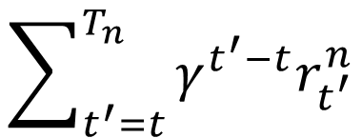

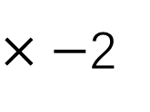









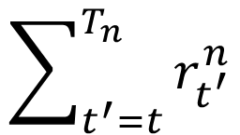


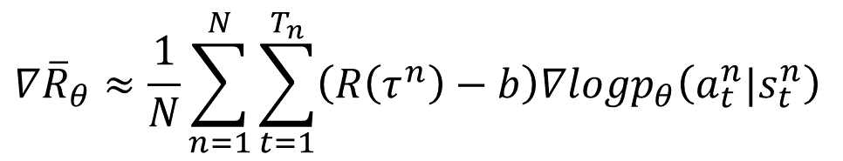

Tip 2: Assign Suitable Credit
Advantage Function
$$A^{θ}\left(s_{t},a_{t}\right)$$
$$×3$$
$×−$2
$$×−2$$
$$∇{\overline{R}}_{θ}≈\frac{1}{N}\sum_{n=1}^{N}{\sum_{t=1}^{T_{n}}{\left(R\left(τ^{n}\right)−b\right)∇logp_{θ}\left(a_{t}^{n}|s_{t}^{n}\right)}}$$
$$\left(s_{a},a_{1}\right)$$
$$\left(s_{b},a_{2}\right)$$
$$\left(s_{c},a_{3}\right)$$
+5
+0
-2
$$\sum_{t^{′}=t}^{T_{n}}{r_{t^{′}}^{n}}$$
$$R=+3$$
$$×−7$$
$$×−2$$
$$×−2$$
$$\left(s_{a},a_{2}\right)$$
$$\left(s_{b},a_{2}\right)$$
$$\left(s_{c},a_{3}\right)$$
$$\sum_{t^{′}=t}^{T_{n}}{γ^{t^{′}−t}r_{t^{′}}^{n}}$$
-5
+0
-2
Add discount factor
$$γ<1$$
$$R=−7$$

Slide 10
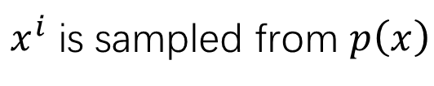

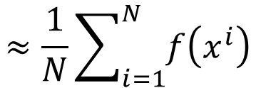
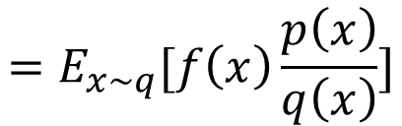

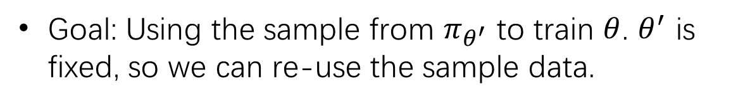
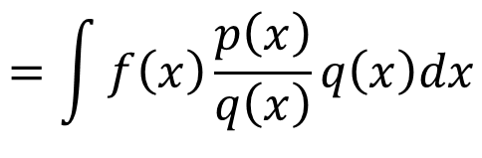

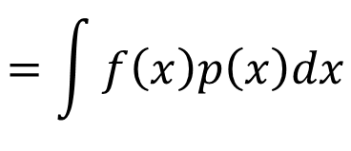


On-policy $→$ Off-policy
$$∇{\overline{R}}_{θ}=E_{τ\sim p_{θ}\left(τ\right)}\left[R\left(τ\right)∇logp_{θ}\left(τ\right)\right]$$
Use $π_{θ}$ to collect data. When $θ$ is updated, we have to sample training data again.
Goal: Using the sample from $π_{θ^{′}}$ to train $θ$. $θ^{′}$ is fixed, so we can re-use the sample data.
Importance Sampling
$x^{i}$ is sampled from $p\left(x\right)$
$$≈\frac{1}{N}\sum_{i=1}^{N}{f\left(x^{i}\right)}$$
$$E_{x\sim p}[f\left(x\right)]$$
We only have $x^{i}$ sampled from $q\left(x\right)$
$$=\int{f\left(x\right)p\left(x\right)dx}$$
$$=\int{f\left(x\right)\frac{p\left(x\right)}{q\left(x\right)}q\left(x\right)dx}$$
$$=E_{x\sim q}[f\left(x\right)\frac{p\left(x\right)}{q\left(x\right)}]$$
Importance weight

Slide 11
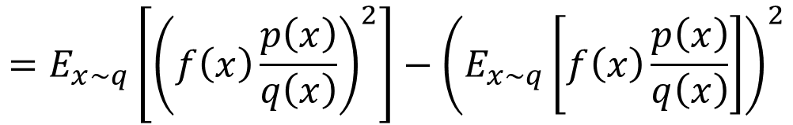
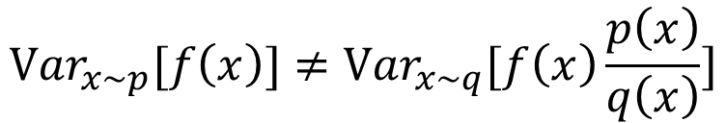
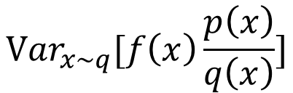
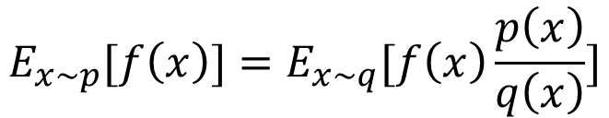
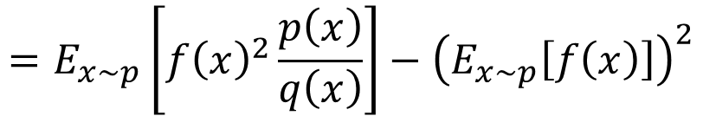
Issue of Importance Sampling
$$E_{x\sim p}[f\left(x\right)]=E_{x\sim q}[f\left(x\right)\frac{p\left(x\right)}{q\left(x\right)}]$$
$${Var}_{x\sim p}[f\left(x\right)]≠{Var}_{x\sim q}[f\left(x\right)\frac{p\left(x\right)}{q\left(x\right)}]$$
$${Var}_{x\sim p}\left[f\left(x\right)\right]=E_{x\sim p}\left[{f\left(x\right)}^{2}\right]−{\left(E_{x\sim p}\left[f\left(x\right)\right]\right)}^{2}$$
$${Var}_{x\sim q}[f\left(x\right)\frac{p\left(x\right)}{q\left(x\right)}]$$
$$=E_{x\sim q}\left[{\left(f\left(x\right)\frac{p\left(x\right)}{q\left(x\right)}\right)}^{2}\right]−{\left(E_{x\sim q}\left[f\left(x\right)\frac{p\left(x\right)}{q\left(x\right)}\right]\right)}^{2}$$
$$=E_{x\sim p}\left[{f\left(x\right)}^{2}\frac{p\left(x\right)}{q\left(x\right)}\right]−{\left(E_{x\sim p}\left[f\left(x\right)\right]\right)}^{2}$$

Slide 12

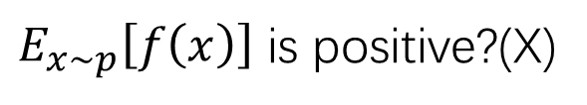
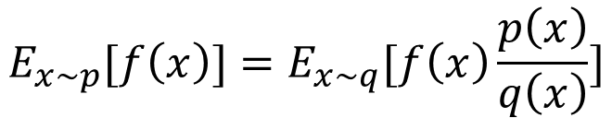
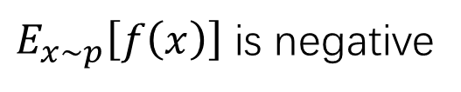


Issue of Importance Sampling
$$E_{x\sim p}[f\left(x\right)]=E_{x\sim q}[f\left(x\right)\frac{p\left(x\right)}{q\left(x\right)}]$$
$E_{x\sim p}\left[f\left(x\right)\right]$ is negative
$$f\left(x\right)$$
$$p\left(x\right)$$
$$q\left(x\right)$$
Very large weight
$E_{x\sim p}\left[f\left(x\right)\right]$ is positive?(X)
negative

Slide 13
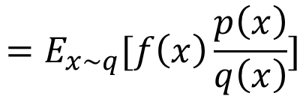


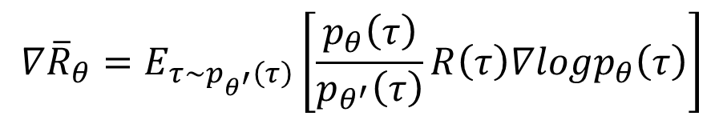
On-policy $→$ Off-policy
$$∇{\overline{R}}_{θ}=E_{τ\sim p_{θ}\left(τ\right)}\left[R\left(τ\right)∇logp_{θ}\left(τ\right)\right]$$
Use $π_{θ}$ to collect data. When $θ$ is updated, we have to sample training data again.
Goal: Using the sample from $π_{θ^{′}}$ to train $θ$. $θ^{′}$ is fixed, so we can re-use the sample data.
$$∇{\overline{R}}_{θ}=E_{τ\sim p_{θ^{′}}\left(τ\right)}\left[\frac{p_{θ}\left(τ\right)}{p_{θ^{′}}\left(τ\right)}R\left(τ\right)∇logp_{θ}\left(τ\right)\right]$$
Sample the data from $θ^{′}$.
Use the data to train $θ$ many times.
Importance Sampling
$$=E_{x\sim q}[f\left(x\right)\frac{p\left(x\right)}{q\left(x\right)}]$$
$$E_{x\sim p}[f\left(x\right)]$$

Slide 14

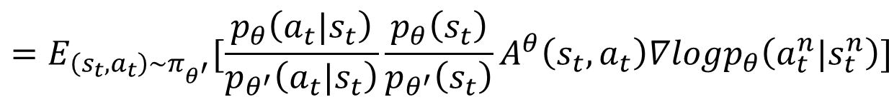
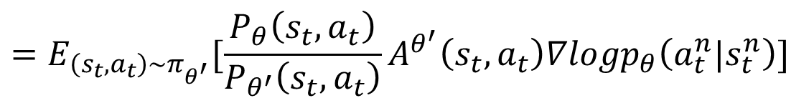
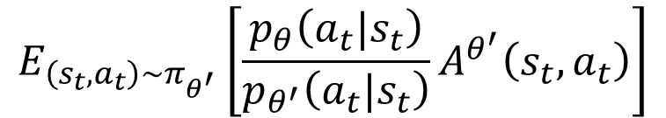
On-policy $→$ Off-policy
Gradient for update
$$=E_{\left(s_{t},a_{t}\right)\sim π_{θ}}[A^{θ}\left(s_{t},a_{t}\right)∇logp_{θ}\left(a_{t}^{n}|s_{t}^{n}\right)]$$
$$=E_{\left(s_{t},a_{t}\right)\sim π_{θ^{′}}}[\frac{P_{θ}\left(s_{t},a_{t}\right)}{P_{θ^{′}}\left(s_{t},a_{t}\right)}A^{θ^{′}}\left(s_{t},a_{t}\right)∇logp_{θ}\left(a_{t}^{n}|s_{t}^{n}\right)]$$
$$=E_{\left(s_{t},a_{t}\right)\sim π_{θ^{′}}}[\frac{p_{θ}\left(a_{t}|s_{t}\right)}{p_{θ^{′}}\left(a_{t}|s_{t}\right)}\frac{p_{θ}\left(s_{t}\right)}{p_{θ^{′}}\left(s_{t}\right)}A^{θ}\left(s_{t},a_{t}\right)∇logp_{θ}\left(a_{t}^{n}|s_{t}^{n}\right)]$$
$$E_{\left(s_{t},a_{t}\right)\sim π_{θ^{′}}}\left[\frac{p_{θ}\left(a_{t}|s_{t}\right)}{p_{θ^{′}}\left(a_{t}|s_{t}\right)}A^{θ^{′}}\left(s_{t},a_{t}\right)\right]$$
$$J^{θ^{′}}\left(θ\right)=$$
Add constraint during importance sampling

Slide 15
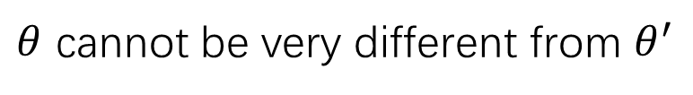



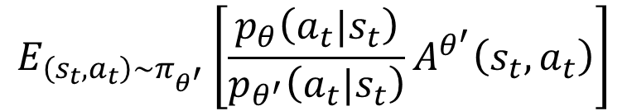


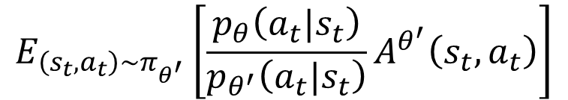

PPO / TRPO
$θ$ cannot be very different from $θ^{′}$
Constraint on behavior not parameters
Proximal Policy Optimization (PPO)
$$∇f\left(x\right)=$$
$$f\left(x\right)∇logf\left(x\right)$$
$$J_{PPO}^{θ^{′}}\left(θ\right)=J^{θ^{′}}\left(θ\right)−βKL\left(θ,θ^{′}\right)$$
$$E_{\left(s_{t},a_{t}\right)\sim π_{θ^{′}}}\left[\frac{p_{θ}\left(a_{t}|s_{t}\right)}{p_{θ^{′}}\left(a_{t}|s_{t}\right)}A^{θ^{′}}\left(s_{t},a_{t}\right)\right]$$
$$J^{θ^{′}}\left(θ\right)=$$
TRPO (Trust Region Policy Optimization)
$$E_{\left(s_{t},a_{t}\right)\sim π_{θ^{′}}}\left[\frac{p_{θ}\left(a_{t}|s_{t}\right)}{p_{θ^{′}}\left(a_{t}|s_{t}\right)}A^{θ^{′}}\left(s_{t},a_{t}\right)\right]$$
$$J_{TRPO}^{θ^{′}}\left(θ\right)=$$
$$KL\left(θ,θ^{′}\right)<δ$$

Slide 16
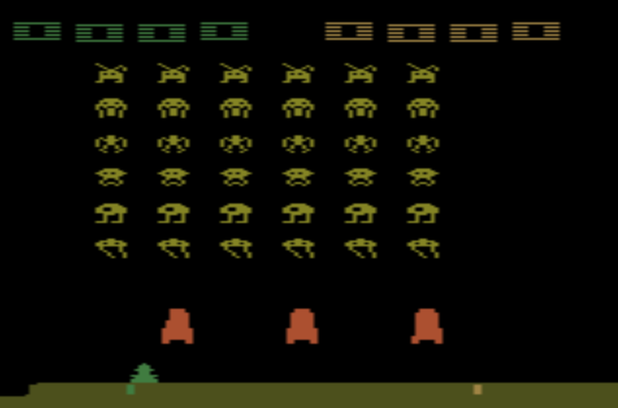
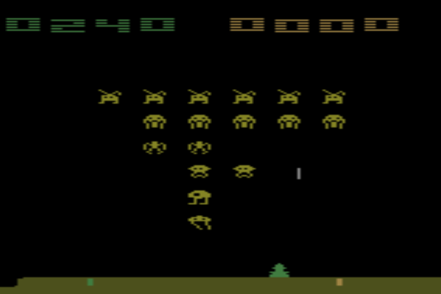
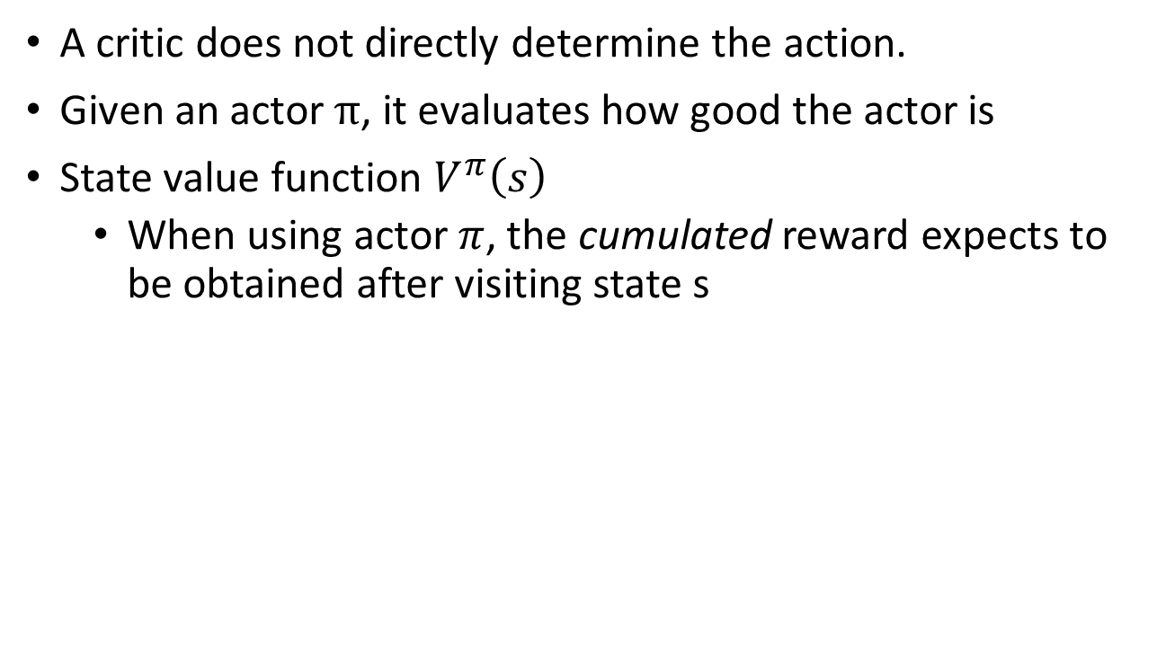




Critic
A critic does not directly determine the action.
Given an actor $π$, it evaluates how good the actor is
State value function $V^{π}\left(s\right)$
When using actor $π$, the cumulated reward expects to be obtained after visiting state s
$$V^{π}$$
$$V^{π}\left(s\right)$$
s
scalar
$V^{π}\left(s\right)$ is large
$V^{π}\left(s\right)$ is smaller
Notes:
(Lots of aliens to be killed, and the shields still exist)

Slide 17














How to estimate $V^{π}\left(s\right)$
Monte-Carlo (MC) based approach
The critic watches $π$ playing the game
After seeing $s_{a}$,
$$V^{π}$$
Until the end of the episode, the cumulated reward is $G_{a}$
$$s_{a}$$
$$V^{π}\left(s_{a}\right)$$
$G_{a}$
After seeing $s_{b}$,
$$V^{π}$$
Until the end of the episode, the cumulated reward is $G_{b}$
$$s_{b}$$
$$V^{π}\left(s_{b} \right)$$
$G_{b}$

Slide 18










How to estimate $V^{π}\left(s\right)$
Temporal-difference (TD) approach
$$⋯s_{t},a_{t},r_{t},s_{t+1}⋯$$
$$V^{π}$$
$$V^{π}\left(s_{t}\right)=V^{π}\left(s_{t+1} \right)+r_{t}$$
$$s_{t}$$
$$V^{π}\left(s_{t}\right)$$
-
$$V^{π}\left(s_{t}\right)−V^{π}\left(s_{t+1}\right)$$
$$r_{t}$$
$$V^{π}$$
$$s_{t+1}$$
$$V^{π}\left(s_{t+1}\right)$$
Notes:
The next most obvious advantage of TD methods over Monte Carlo methods is
that they are naturally implemented in an on-line, fully incremental fashion. With
Monte Carlo methods one must wait until the end of an episode, because only then
is the return known, whereas with TD methods one need wait only one time step.
Surprisingly often this turns out to be a critical consideration Other applications are continuing tasks and have no episodes at all.

Slide 19












MC vs TD
$$V^{π}$$
Larger variance
$$s_{a}$$
$$V^{π}\left(s_{a}\right)$$
$G_{a}$
$G_{a}$ is the summation of many steps
$$V^{π}$$
$$V^{π}$$
$$s_{t}$$
$$V^{π}\left(s_{t}\right)$$
$$r+$$
$$V^{π}\left(s_{t+1}\right)$$
$$s_{t+1}$$
Smaller variance
May be inaccurate

Slide 20







Another Critic: Q-Value
State-action value function $Q^{π}\left(s,a\right)$
When using actor $π$, the cumulated reward expects to be obtained after taking a at state s
$$Q^{π}$$
$$Q^{π}$$
$$Q^{π}\left(s,a=left\right)$$
s
$$Q^{π}\left(s,a\right)$$
s
$$Q^{π}\left(s,a=right\right)$$
scalar
a
$$Q^{π}\left(s,a=fire\right)$$
for discrete action only

Slide 21


Q-Learning
$π$ interacts with the environment
𝜋 interacts with the environment
Learning $Q^{π}\left(s,a\right)$
Learning 𝑄^𝜋 (𝑠,𝑎)
Find a new actor $π^{′}$ “better” than $π$
Find a new actor 𝜋^′ “better” than 𝜋
TD or MC
$$π=π^{′}$$
$$π^{′}\left(s\right)=arg\max_{a}{Q^{π}\left(s,a\right)}$$
Notes:
Add some noise

Slide 22












Target Network
$$⋯s_{t},a_{t},r_{t},s_{t+1}⋯$$
$$Q^{π}\left(s_{t},a_{t}\right)$$
$$=r_{t}+Q^{π}\left(s_{t+1},π\left(s_{t+1}\right)\right)$$
$$Q^{π}$$
$$s_{t}$$
$$Q^{π}\left(s_{t},a_{t}\right)$$
Target Network
$$a_{t}$$
regression
update
$$Q^{π}$$
$$s_{t+1}$$
$$r_{t}+$$
$$Q^{π}\left(s_{t+1},π\left(s_{t+1}\right)\right)$$
fixed value
$$π\left(s_{t+1}\right)$$
fixed
After updating N times

Slide 23













Exploration
$$a_{1}$$
$$Q\left(s,a\right)=0$$
Never explore
$$s$$
$$a_{2}$$
$Q\left(s,a\right)=0$->1
Always sampled
$$a_{3}$$
$$Q\left(s,a\right)=0$$
Never explore
The policy is based on Q-function
$$a=arg\max_{a}{Q\left(s,a\right)}$$
$ε$ would decay during learning
Epsilon Greedy
$$a=\left\{\begin{aligned}arg\max_{a}{Q\left(s,a\right)}, \\ &random, \end{aligned}\right.$$
$$with probability 1−ε$$
$$otherwise$$
Boltzmann Exploration
$$P\left(a|s\right)=\frac{exp\left(Q\left(s,a\right)\right)}{\sum_{a}{exp\left(Q\left(s,a\right)\right)}}$$
Notes:
就好像去餐廳點一道菜

Slide 24


Replay Buffer
…
Buffer
exp
exp
Put the experience into buffer.
$$s_{t},a_{t},r_{t},s_{t+1}$$
exp
$π$ interacts with the environment
𝜋 interacts with the environment
Learning $Q^{π}\left(s,a\right)$
Learning 𝑄^𝜋 (𝑠,𝑎)
Find a new actor $π^{′}$ “better” than $π$
Find a new actor 𝜋^′ “better” than 𝜋
exp
…
The experience in the buffer comes from different policies.
$$π=π^{′}$$
In each iteration:
1. Sample a batch
2. Update Q-function
Off-policy

Slide 25

Typical Q-Learning Algorithm
…
exp
exp
Initialize Q-function $Q$, target Q-function $\hat{Q}=Q$
In each episode
For each time step t
Given state $s_{t}$, take action $a_{t}$ based on Q (epsilon greedy)
Obtain reward $r_{t}$, and reach new state $s_{t+1}$
Store ($s_{t}$, $a_{t}$, $r_{t}$, $s_{t+1}$) into buffer
Sample ($s_{i}$, $a_{i}$, $r_{i}$, $s_{i+1}$) from buffer (usually a batch)
Target $y=r_{i}+\max_{a}{\hat{Q}\left(s_{i+1},a\right)}$
Update the parameters of $Q$ to make $Q\left(s_{i}\text{, }a_{i}\right)$ close to $y$ (regression)
Every C steps reset $\hat{Q}=Q$
exp
$π$ interacts with the environment
𝜋 interacts with the environment
Learning $Q^{π}\left(s,a\right)$
Learning 𝑄^𝜋 (𝑠,𝑎)
Find a new actor $π^{′}$ “better” than $π$
Find a new actor 𝜋^′ “better” than 𝜋
exp
…

Slide 26



Continuous Actions
Action $a$ is a continuous vector
$$a=arg\max_{a}{Q\left(s,a\right)}$$
Solution 1
Sample a set of actions: $\left\{a_{1},a_{2},⋯,a_{N}\right\}$
See which action can obtain the largest Q value
Solution 2
Using gradient ascent to solve the optimization problem.

Slide 27
Continuous Actions
Solution 3
Don’t use Q-learning
Policy-based
Value-based
Learning an Actor
Actor + Critic
Learning a Critic

Slide 28






Actor-Critic
$$Q^{π_{θ}}\left(s_{t}^{n},a_{t}^{n}\right)−V^{π_{θ}}\left(s_{t}^{n}\right)$$
$$V^{π_{θ}}\left(s_{t}^{n}\right)$$
baseline
$$∇{\overline{R}}_{θ}≈\frac{1}{N}\sum_{n=1}^{N}{\sum_{t=1}^{T_{n}}{\left(\sum_{t^{′}=t}^{T_{n}}{γ^{t^{′}−t}r_{t^{′}}^{n}}−b\right)∇logp_{θ}\left(a_{t}^{n}|s_{t}^{n}\right)}}$$
$G_{t}^{n}$: obtained via interaction
$$E\left[G_{t}^{n}\right]=$$
$$Q^{π_{θ}}\left(s_{t}^{n},a_{t}^{n}\right)$$

Slide 29




Advantage Actor-Critic
Estimate two networks? We can only estimate one.
$$Q^{π}\left(s_{t}^{n},a_{t}^{n}\right)−V^{π}\left(s_{t}^{n}\right)$$
Only estimate state value
$$r_{t}^{n}+V^{π}\left(s_{t+1}^{n}\right)−V^{π}\left(s_{t}^{n}\right)$$
A little bit variance
$$Q^{π}\left(s_{t}^{n},a_{t}^{n}\right)=E\left[r_{t}^{n}+V^{π}\left(s_{t+1}^{n}\right)\right]$$
$$Q^{π}\left(s_{t}^{n},a_{t}^{n}\right)=r_{t}^{n}+V^{π}\left(s_{t+1}^{n}\right)$$

Slide 30


Advantage Actor-Critic
$π$ interacts with the environment
𝜋 interacts with the environment
Learning $V^{π}\left(s\right)$
Learning 𝑉^𝜋 (𝑠)
Update actor from $π→π’$ based on $V^{π}\left(s\right)$
Update actor from 𝜋→𝜋’ based on 𝑉^𝜋 (𝑠)
$$π=π^{′}$$
TD or MC
$$∇{\overline{R}}_{θ}≈\frac{1}{N}\sum_{n=1}^{N}{\sum_{t=1}^{T_{n}}{\left(r_{t}^{n}+V^{π}\left(s_{t+1}^{n}\right)−V^{π}\left(s_{t}^{n}\right)\right)∇logp_{θ}\left(a_{t}^{n}|s_{t}^{n}\right)}}$$

Slide 31



Advantage Actor-Critic
Tips
The parameters of actor $π\left(s\right)$ and critic $V^{π}\left(s\right)$ can be shared
Use output entropy as regularization for $π\left(s\right)$
Larger entropy is preferred $→$ exploration
Network
left
Network
right
$$s$$
fire
Network
$$V^{π}\left(s\right)$$

Slide 32







Asynchronous
Advantage Actor-Critic
$$θ^{1}$$
$$+η∆θ$$
$$θ^{2}$$
1. Copy global parameters
(other workers also update models)
2. Sampling some data
$$∆θ$$
3. Compute gradients
4. Update global models
$$θ^{1}$$
$$∆θ$$

Slide 33


Slide 34
Connection with GAN
David Pfau, Oriol Vinyals, “Connecting Generative Adversarial Networks and Actor-Critic Methods”, arXiv preprint, 2016

Slide 35
Thanks!

